Slide 1
Process Concept
Process Concept
Process Scheduling
Operations on Processes
Cooperating Processes

Slide 2
Process Concept
An operating system executes a variety of programs:
Batch system – jobs
Time-shared systems – user programs or tasks
Textbook uses the terms job and process almost interchangeably
Process – a program in execution; process execution must progress in sequential fashion
A process includes:
program counter
stack
data section

Slide 3
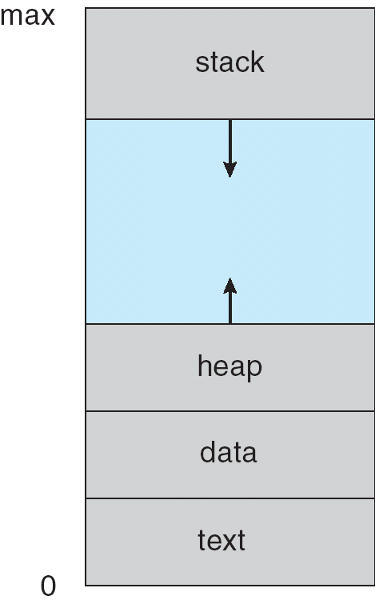
Process in Memory

Slide 4
Process State
As a process executes, it changes state
new: The process is being created
running: Instructions are being executed
waiting: The process is waiting for some event to occur
ready: The process is waiting to be assigned to a process
terminated: The process has finished execution

Slide 5
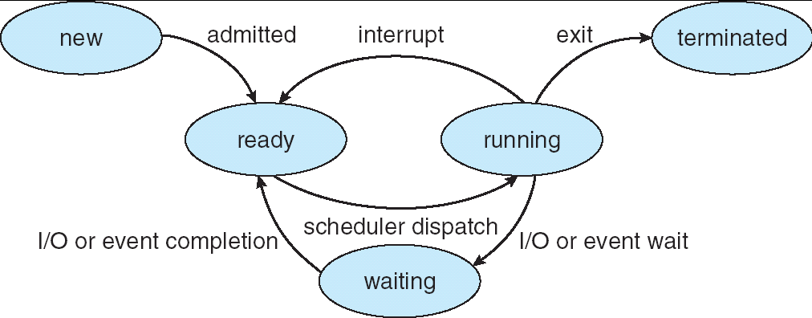
Diagram of Process State

Slide 6
Process Control Block (PCB)
Information associated with each process
Process state
Program counter
CPU registers
CPU scheduling information
Memory-management information
Accounting information
I/O status information

Slide 7
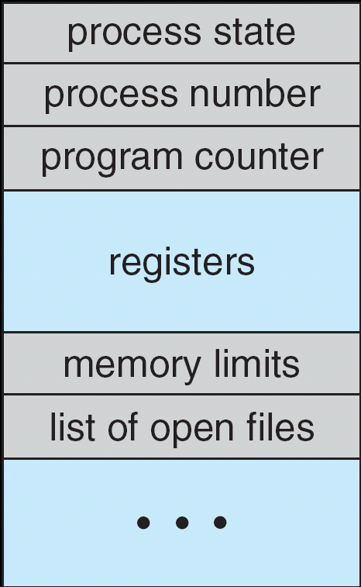
Process Control Block (PCB)

Slide 8
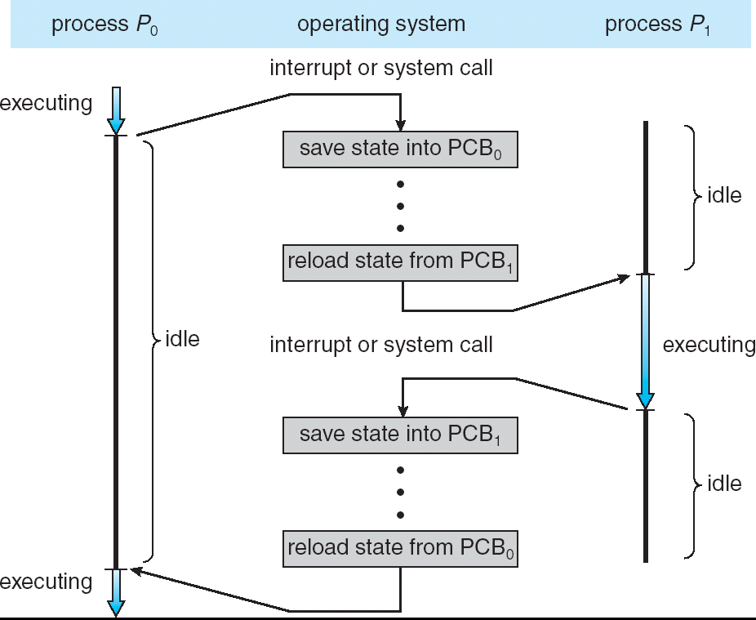
CPU Switch From Process to Process

Slide 9
Process Scheduling Queues
Job queue – set of all processes in the system
Ready queue – set of all processes residing in main memory, ready and waiting to execute
Device queues – set of processes waiting for an I/O device
Processes migrate among the various queues

Slide 10
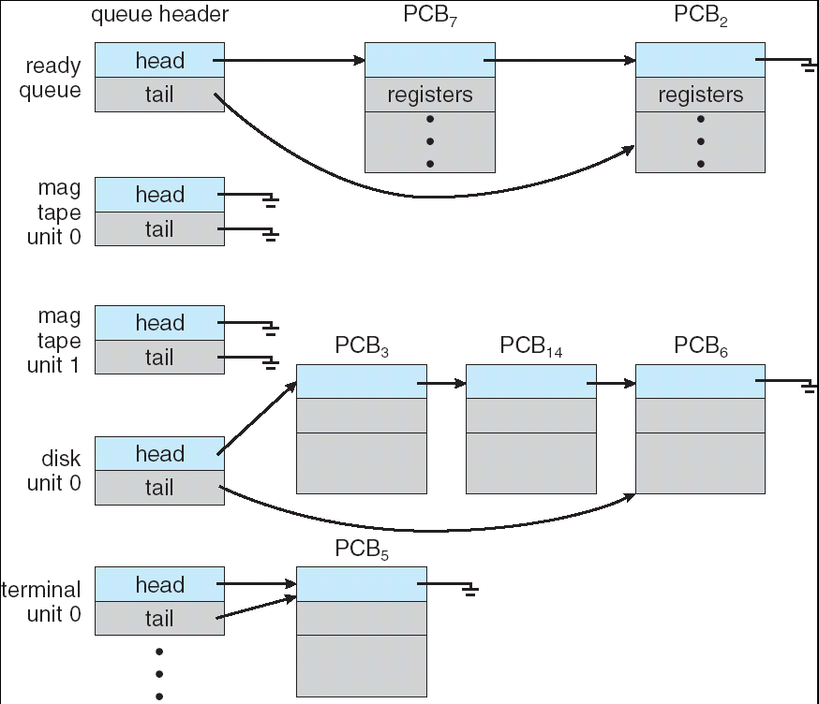
Ready Queue And Various I/O Device Queues

Slide 11
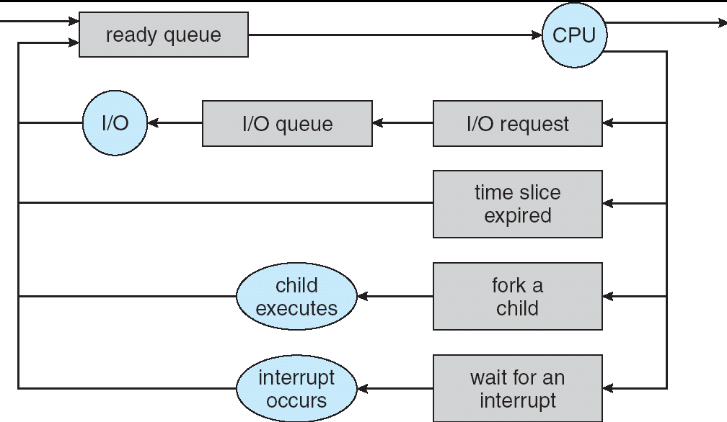
Representation of Process Scheduling

Slide 12
Schedulers
Long-term scheduler (or job scheduler) – selects which processes should be brought into the ready queue
Short-term scheduler (or CPU scheduler) – selects which process should be executed next and allocates CPU

Slide 13
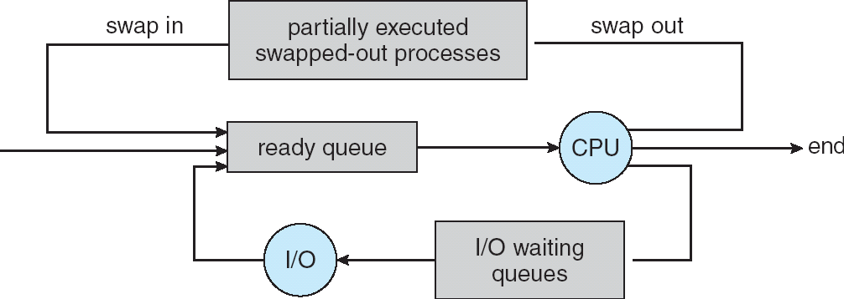
Addition of Medium Term Scheduling

Slide 14
Schedulers (Cont.)
Short-term scheduler is invoked very frequently (milliseconds) ⇒ (must be fast)
Long-term scheduler is invoked very infrequently (seconds, minutes) ⇒ (may be slow)
The long-term scheduler controls the degree of multiprogramming
Processes can be described as either:
I/O-bound process – spends more time doing I/O than computations, many short CPU bursts
CPU-bound process – spends more time doing computations; few very long CPU bursts

Slide 15
Context Switch
When CPU switches to another process, the system must save the state of the old process and load the saved state for the new process
Context-switch time is overhead; the system does no useful work while switching
Time dependent on hardware support

Slide 16
Process Creation
Parent process create children processes, which, in turn create other processes, forming a tree of processes
Resource sharing
Parent and children share all resources
Children share subset of parent’s resources
Parent and child share no resources
Execution
Parent and children execute concurrently
Parent waits until children terminate

Slide 17
Process Creation (Cont.)
Address space
Child duplicate of parent
Child has a program loaded into it
UNIX examples
fork system call creates new process
exec system call used after a fork to replace the process’ memory space with a new program

Slide 18
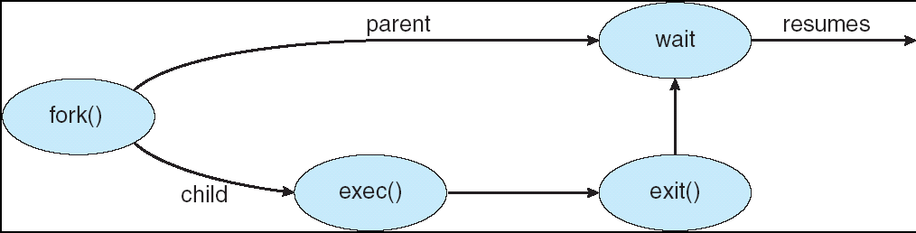
Process Creation

Slide 19
C Program Forking Separate Process
int main()
{
Pid_t pid;
/* fork another process */
pid = fork();
if (pid < 0) { /* error occurred */
fprintf(stderr, "Fork Failed");
exit(-1);
}
else if (pid == 0) { /* child process */
execlp("/bin/ls", "ls", NULL);
}
else { /* parent process */
/* parent will wait for the child to complete */
wait (NULL);
printf ("Child Complete");
exit(0);
}
}

Slide 20
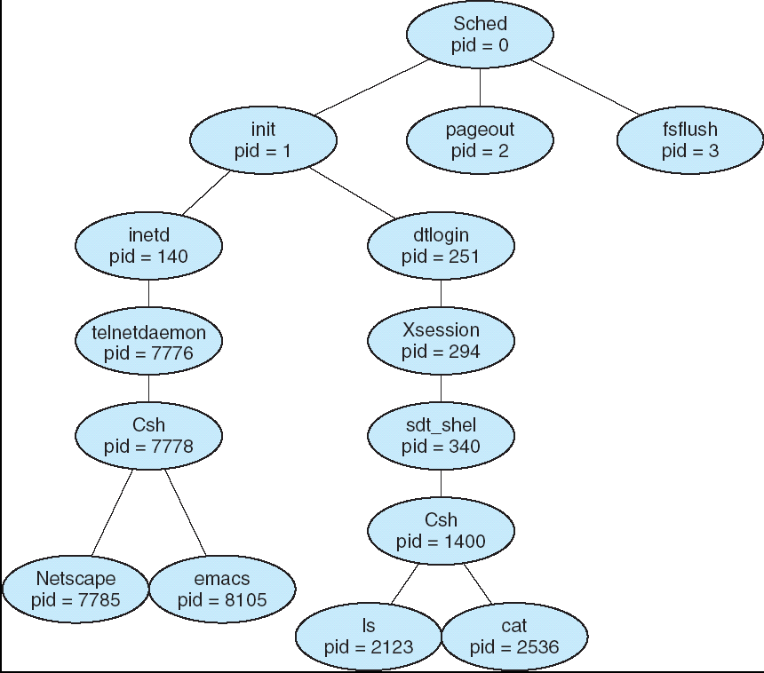
A tree of processes on a typical Solaris

Slide 21
Process Termination
Process executes last statement and asks the operating system to delete it (exit)
Output data from child to parent (via wait)
Process’ resources are deallocated by operating system
Parent may terminate execution of children processes (abort)
Child has exceeded allocated resources
Task assigned to child is no longer required
If parent is exiting
Some operating system do not allow child to continue if its parent terminates
All children terminated - cascading termination

Slide 22
Cooperating Processes
Independent process cannot affect or be affected by the execution of another process
Cooperating process can affect or be affected by the execution of another process
Advantages of process cooperation
Information sharing
Computation speed-up
Modularity
Convenience

